Slide 1
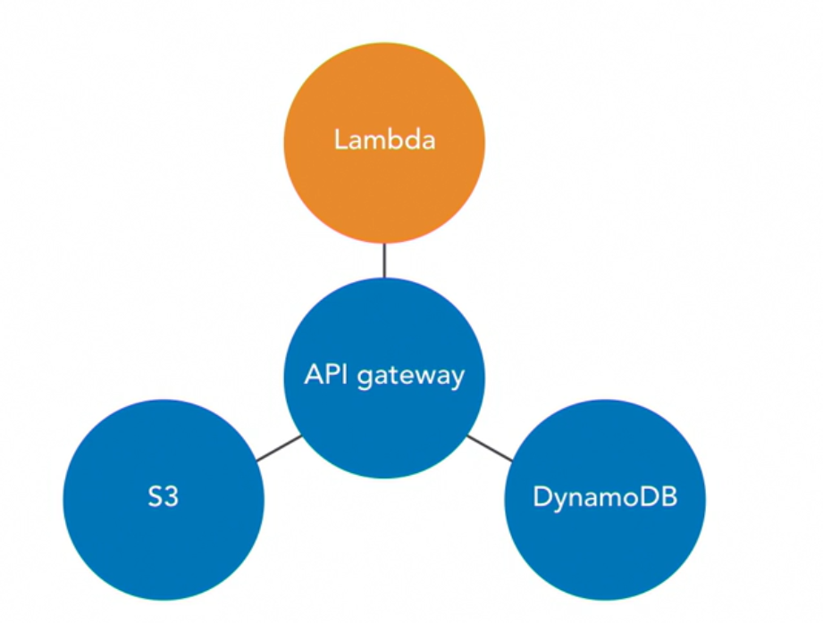

Slide 2
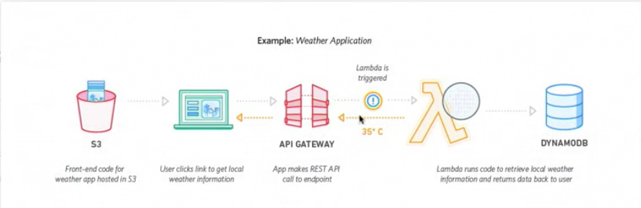

Slide 3
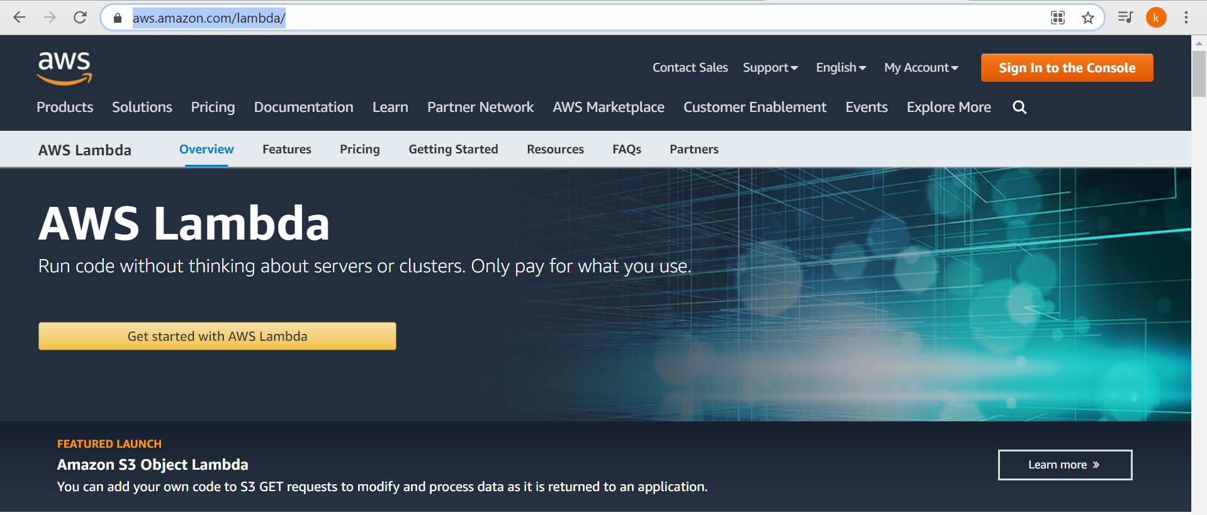
Notes:
https://aws.amazon.com/lambda/

Slide 4
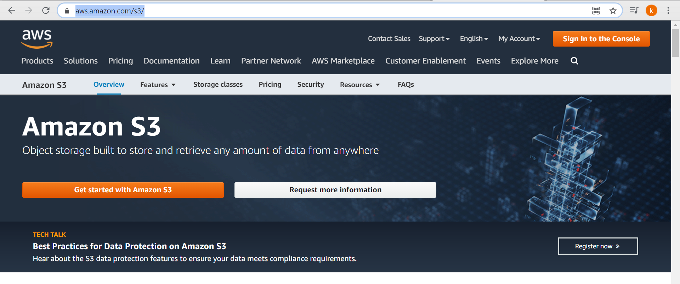
Notes:
https://aws.amazon.com/s3/

Slide 5
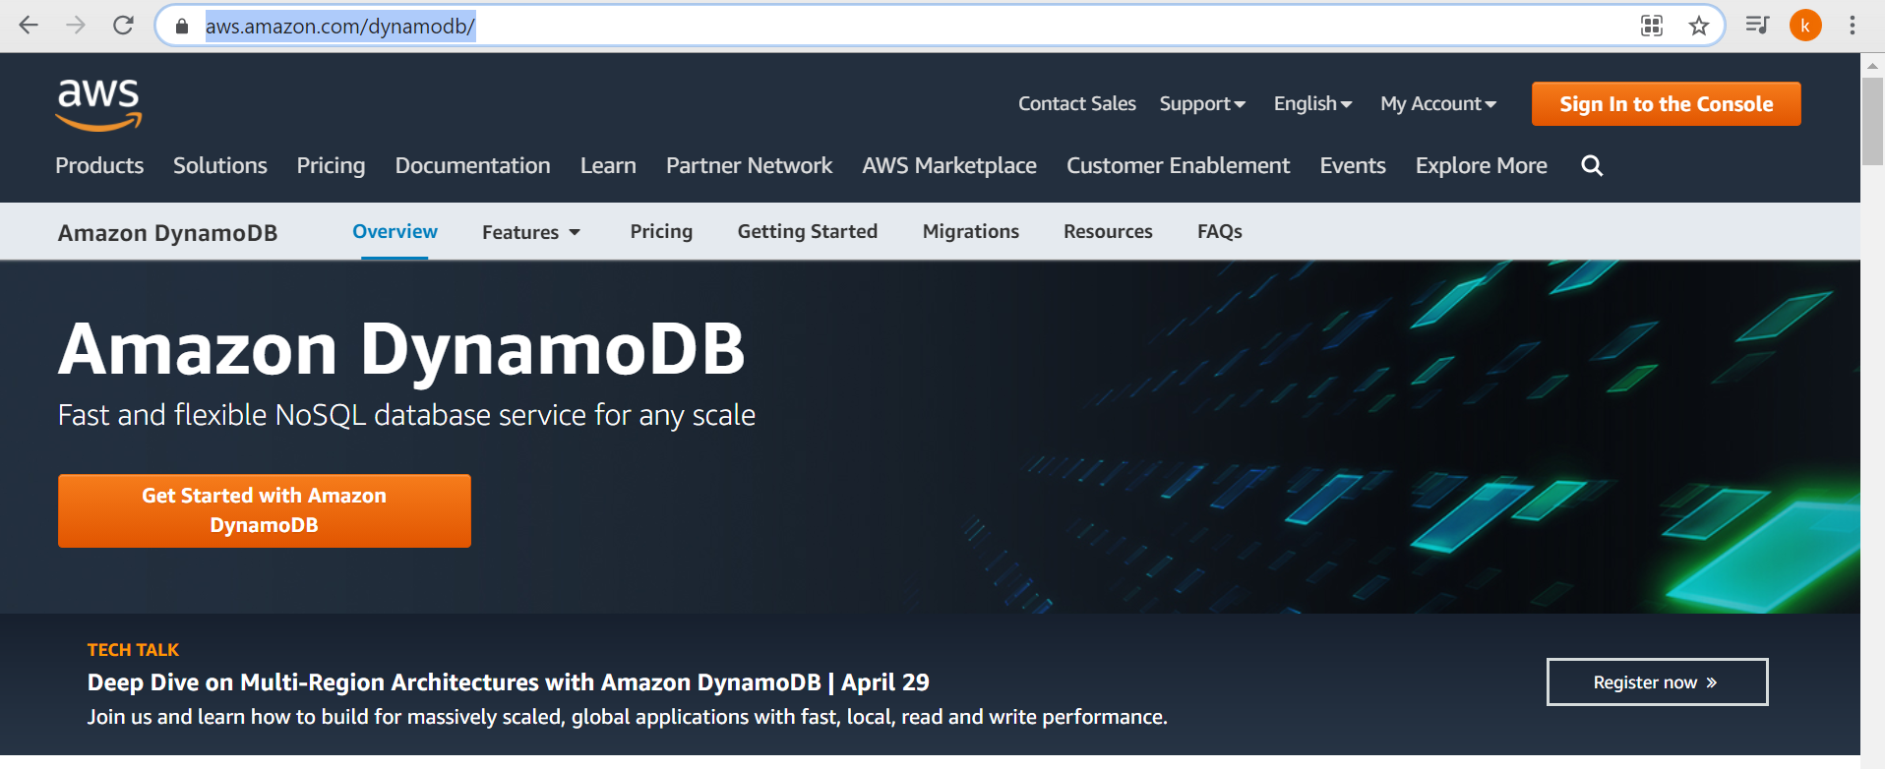
Notes:
https://aws.amazon.com/dynamodb/

Slide 6
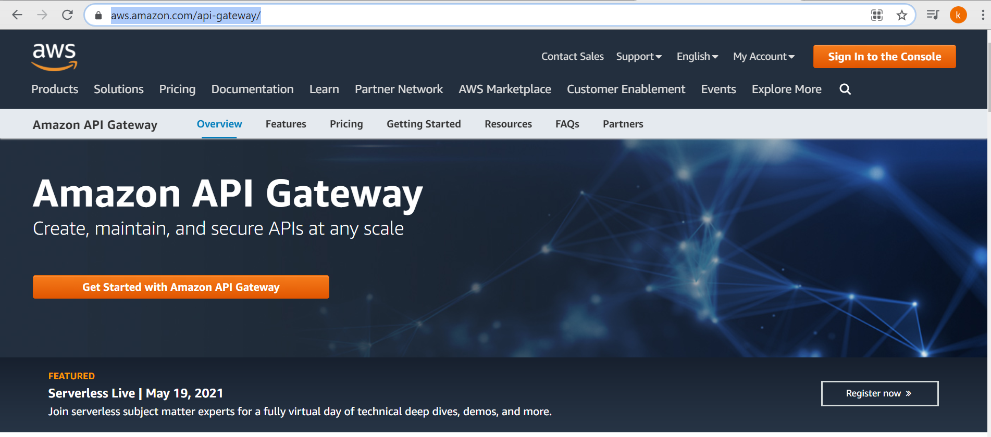
Notes:
https://aws.amazon.com/api-gateway/

Slide 7
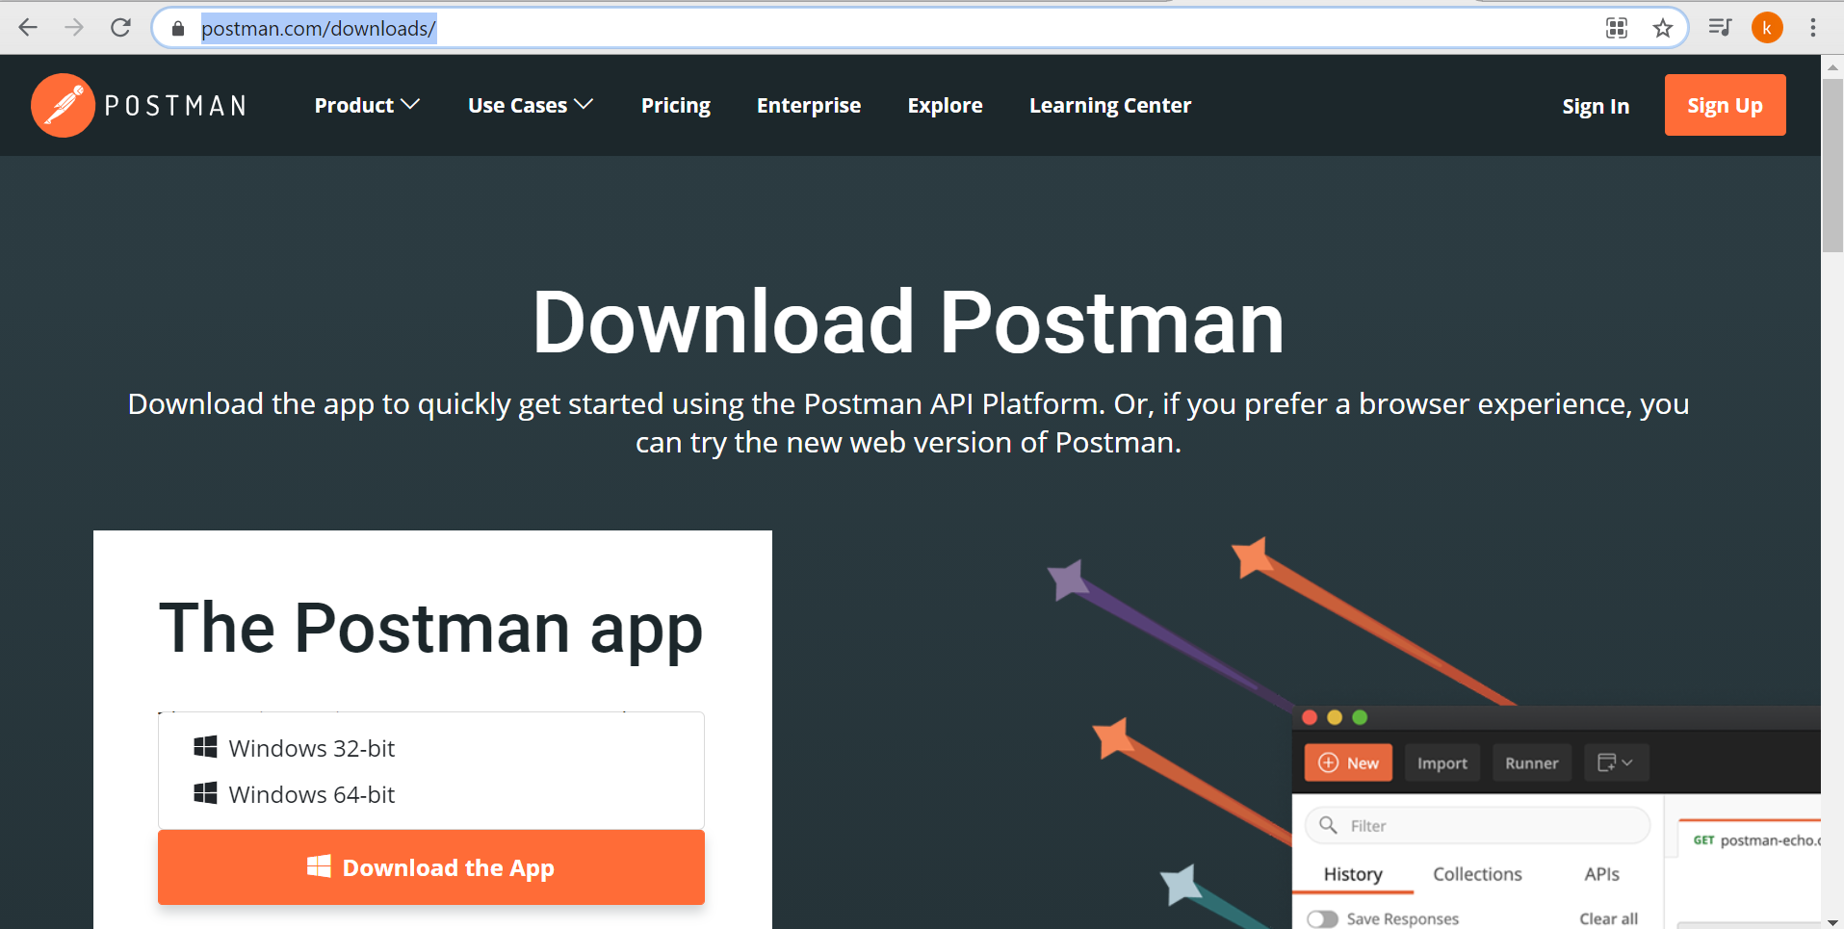
Notes:
https://www.postman.com/downloads/

